Slide 1
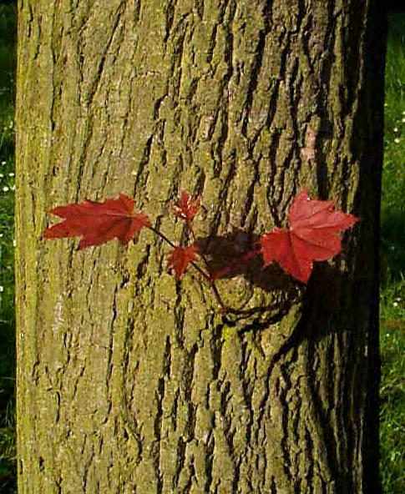
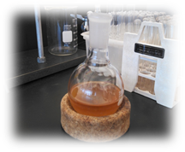
Extraction
Isolation
Structural characterization
Sugar maple bark
Anti-inflammatory activity
Partial chemical structure of α-(1→6) heteroglucan

Slide 2
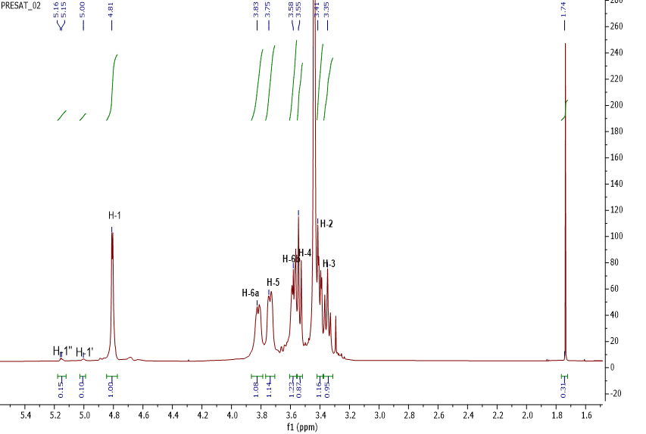
A
B

